Slide 1
LGD project
Team A
MUGGULLA DHARANI SAI SRIRAM

Slide 2
Introduction
To create a web-based management system for learning and development, providing dashboards for admins, managers, and employees to manage and track progress. Technologies Used:
Backend: Django
Frontend: HTML, CSS, JavaScript
Database: sqlLite

Slide 3
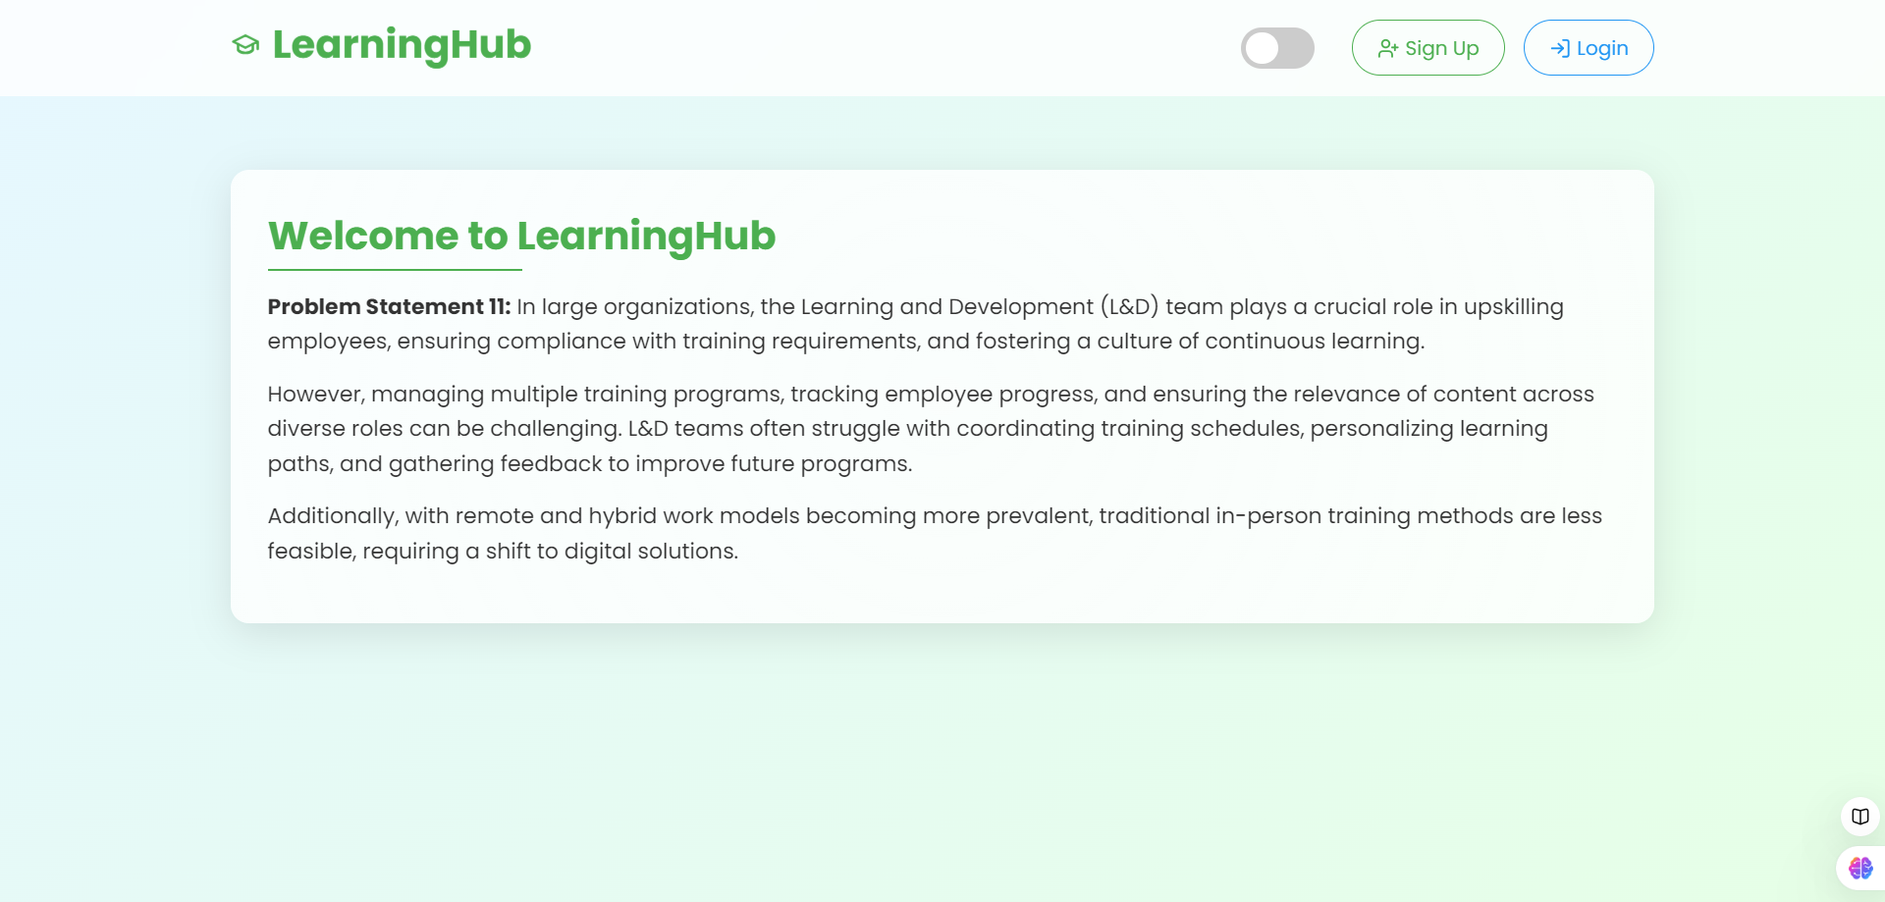
Home Page

Slide 4
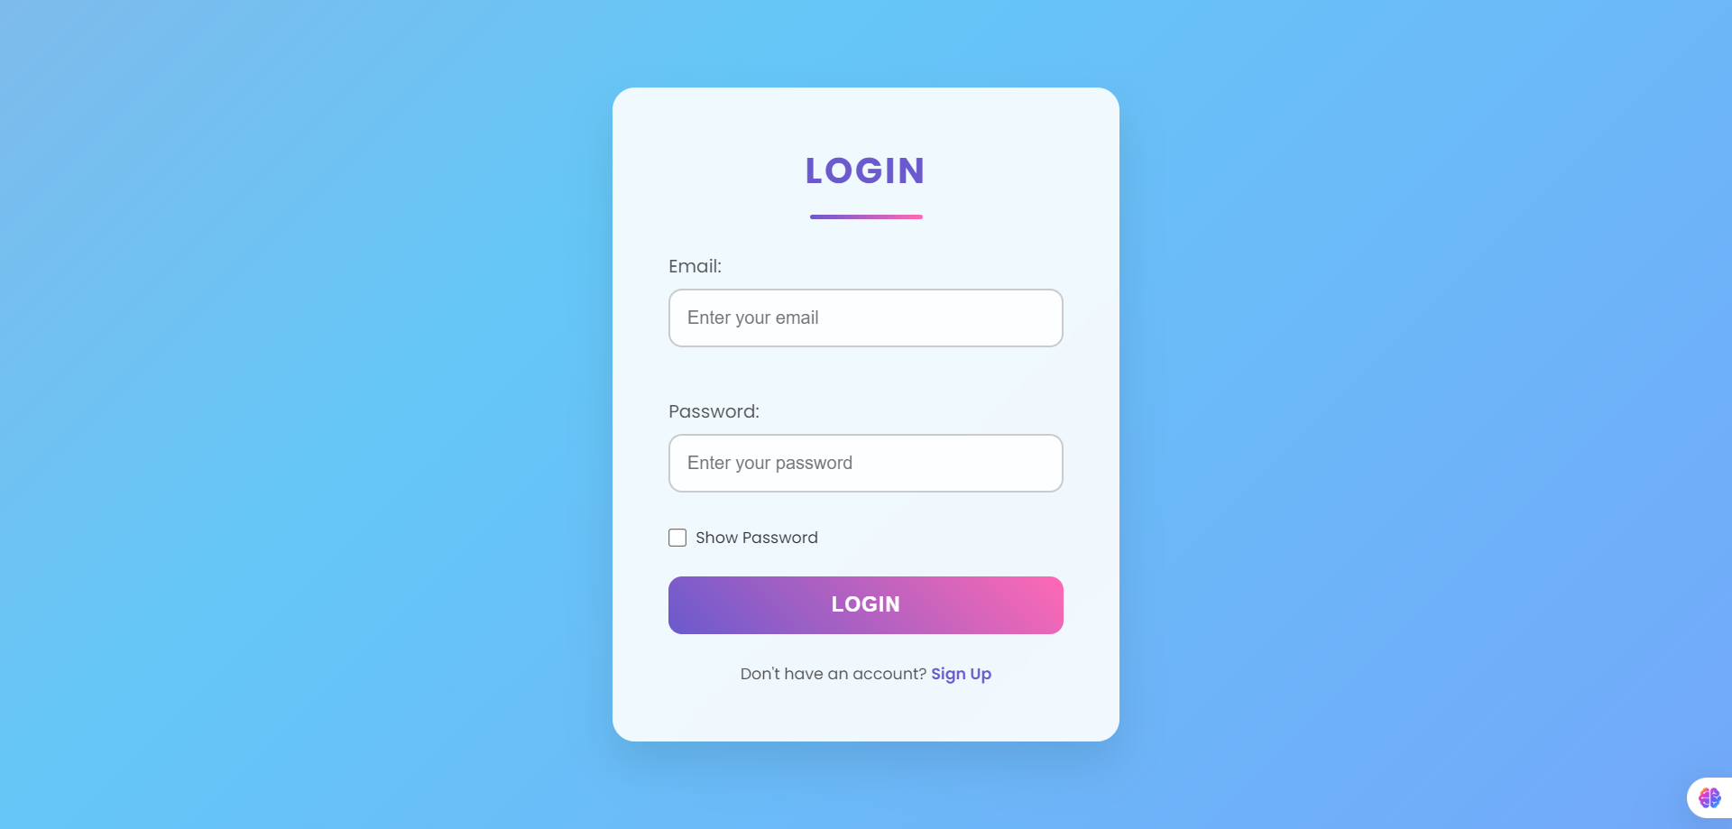
Login page

Slide 5
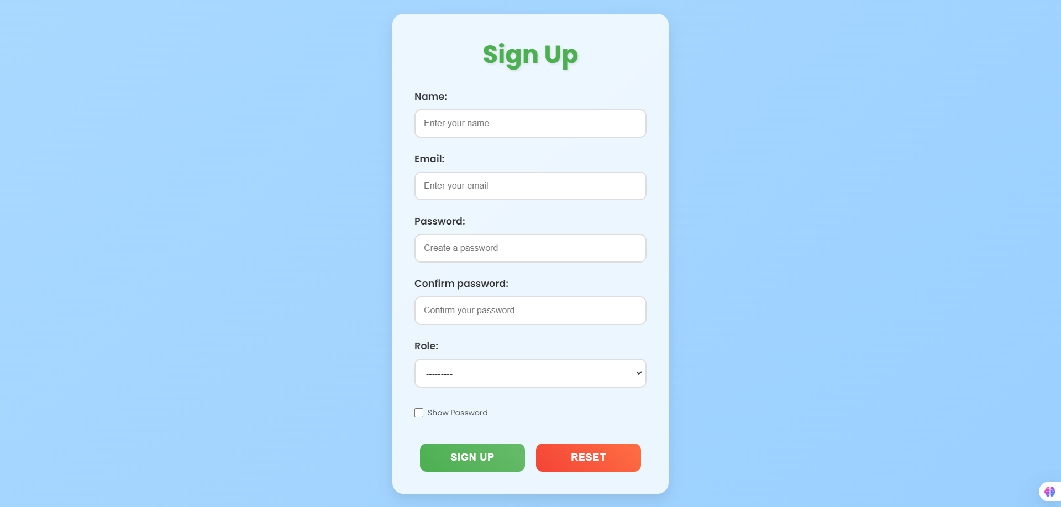
Signup page

Slide 6
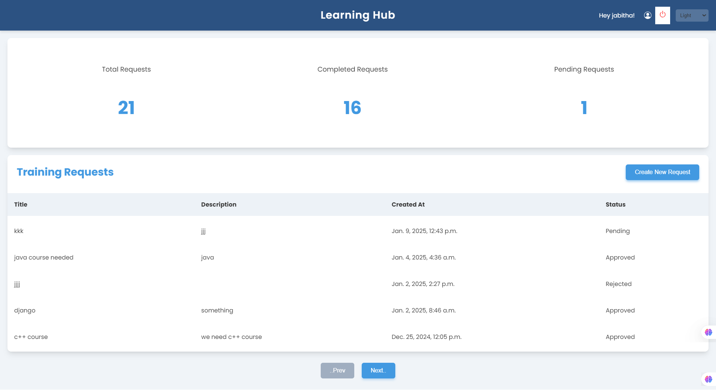
Manager page

Slide 7
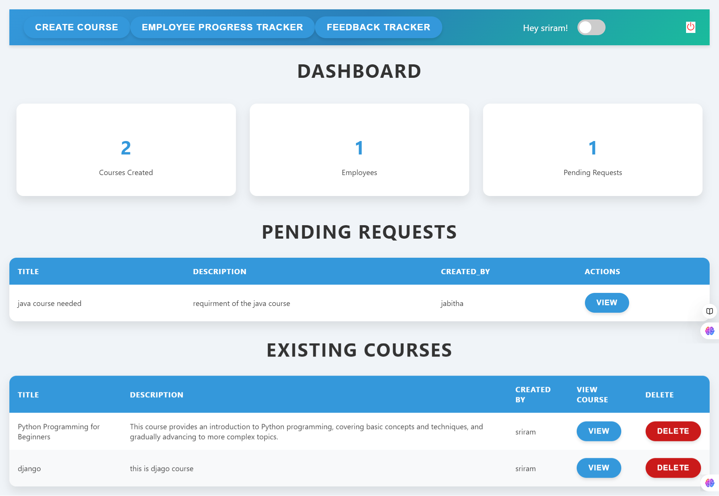
Admin page

Slide 8
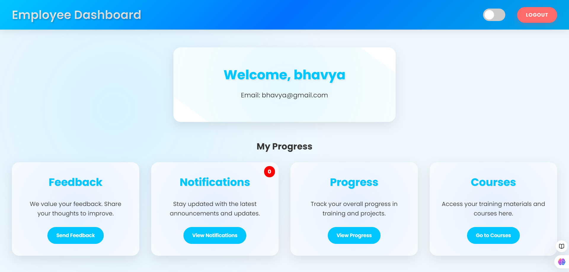
Employee page

Slide 9
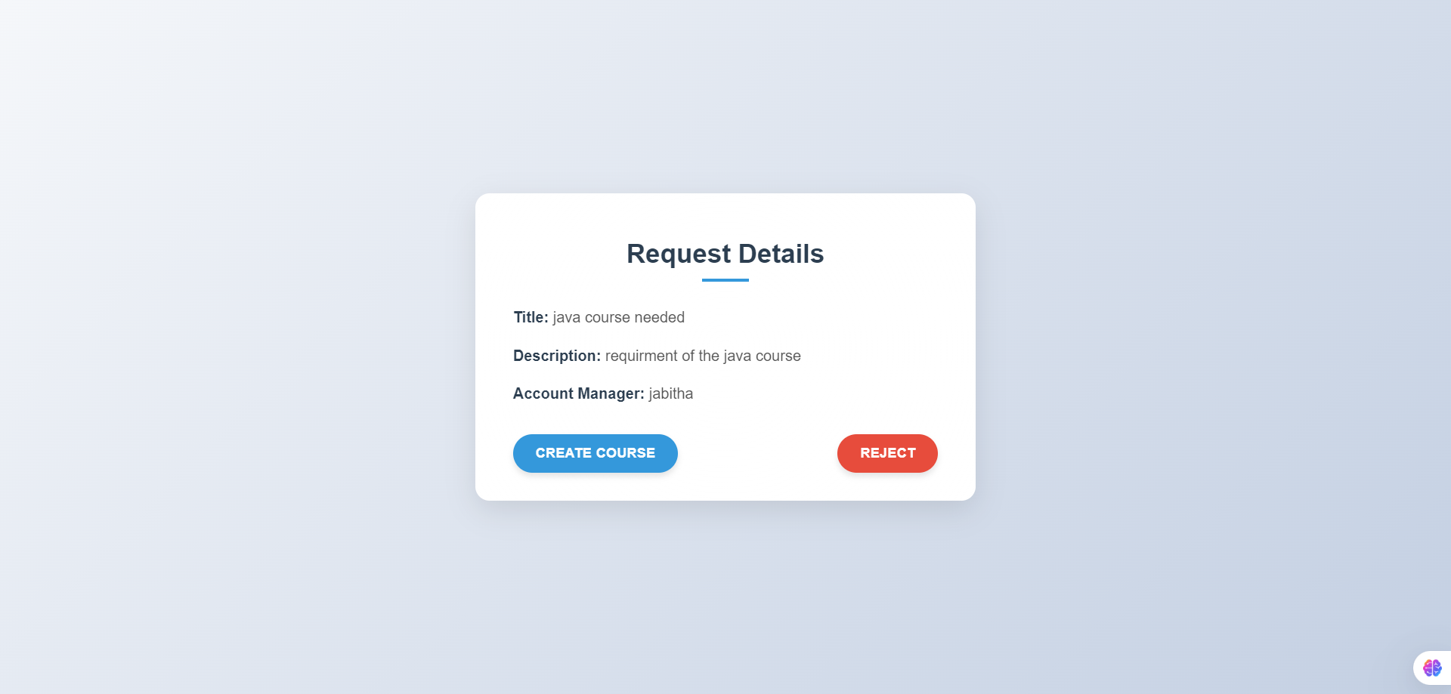
Admin action on the training request

Slide 10
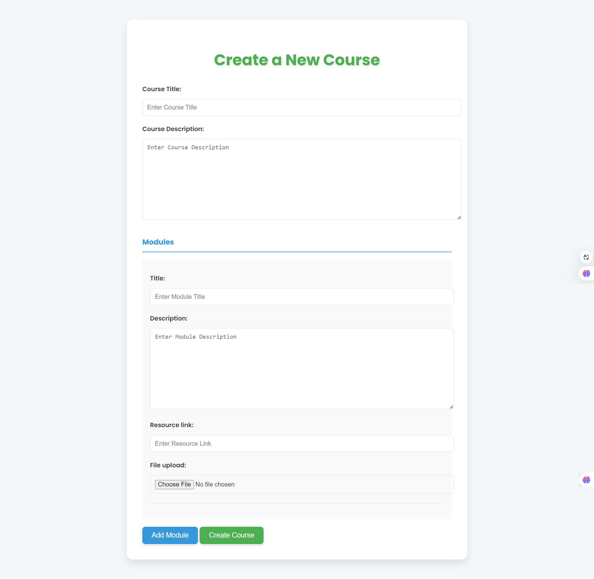
course creation page

Slide 11
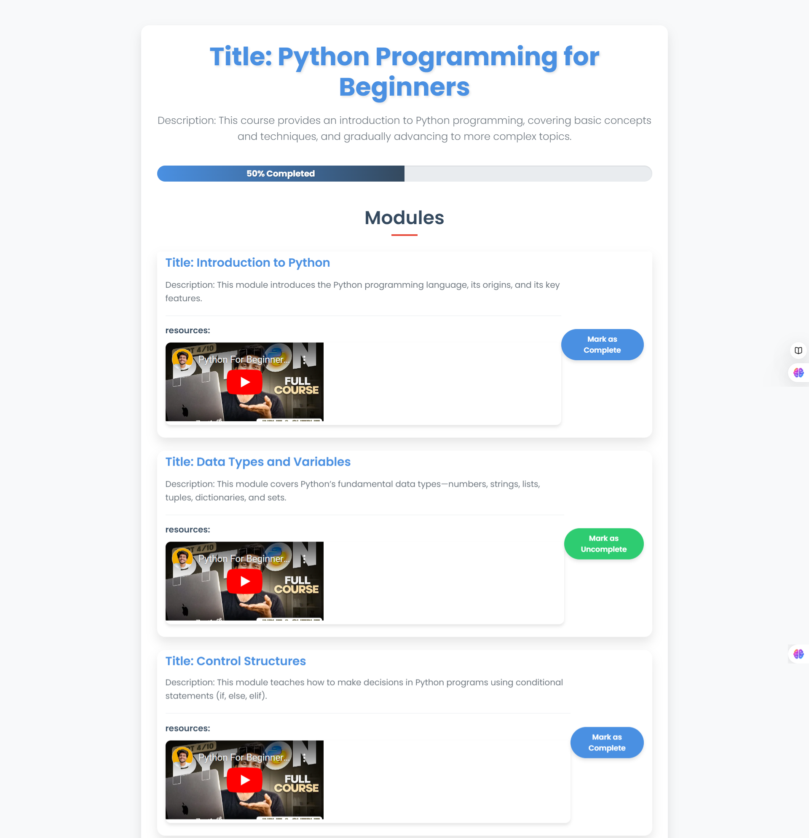
course page

Slide 12
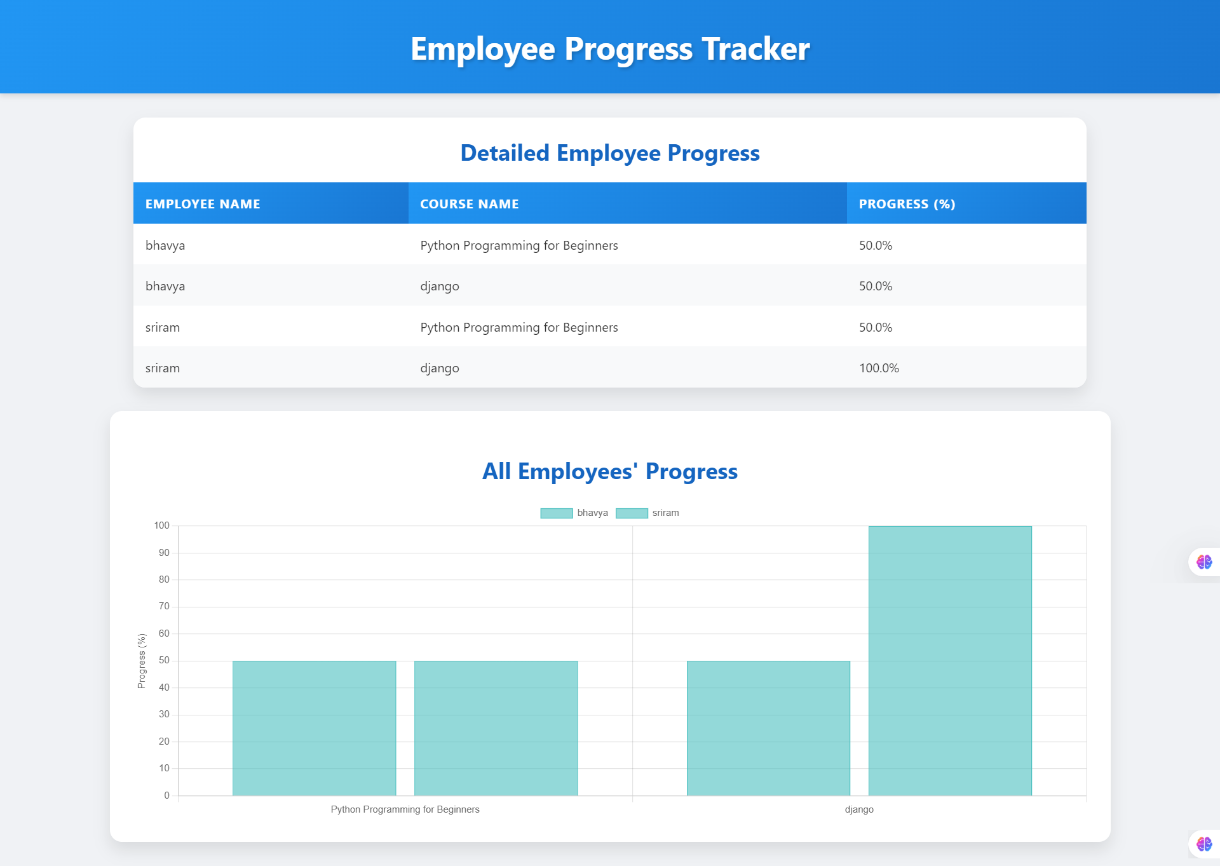

Slide 13
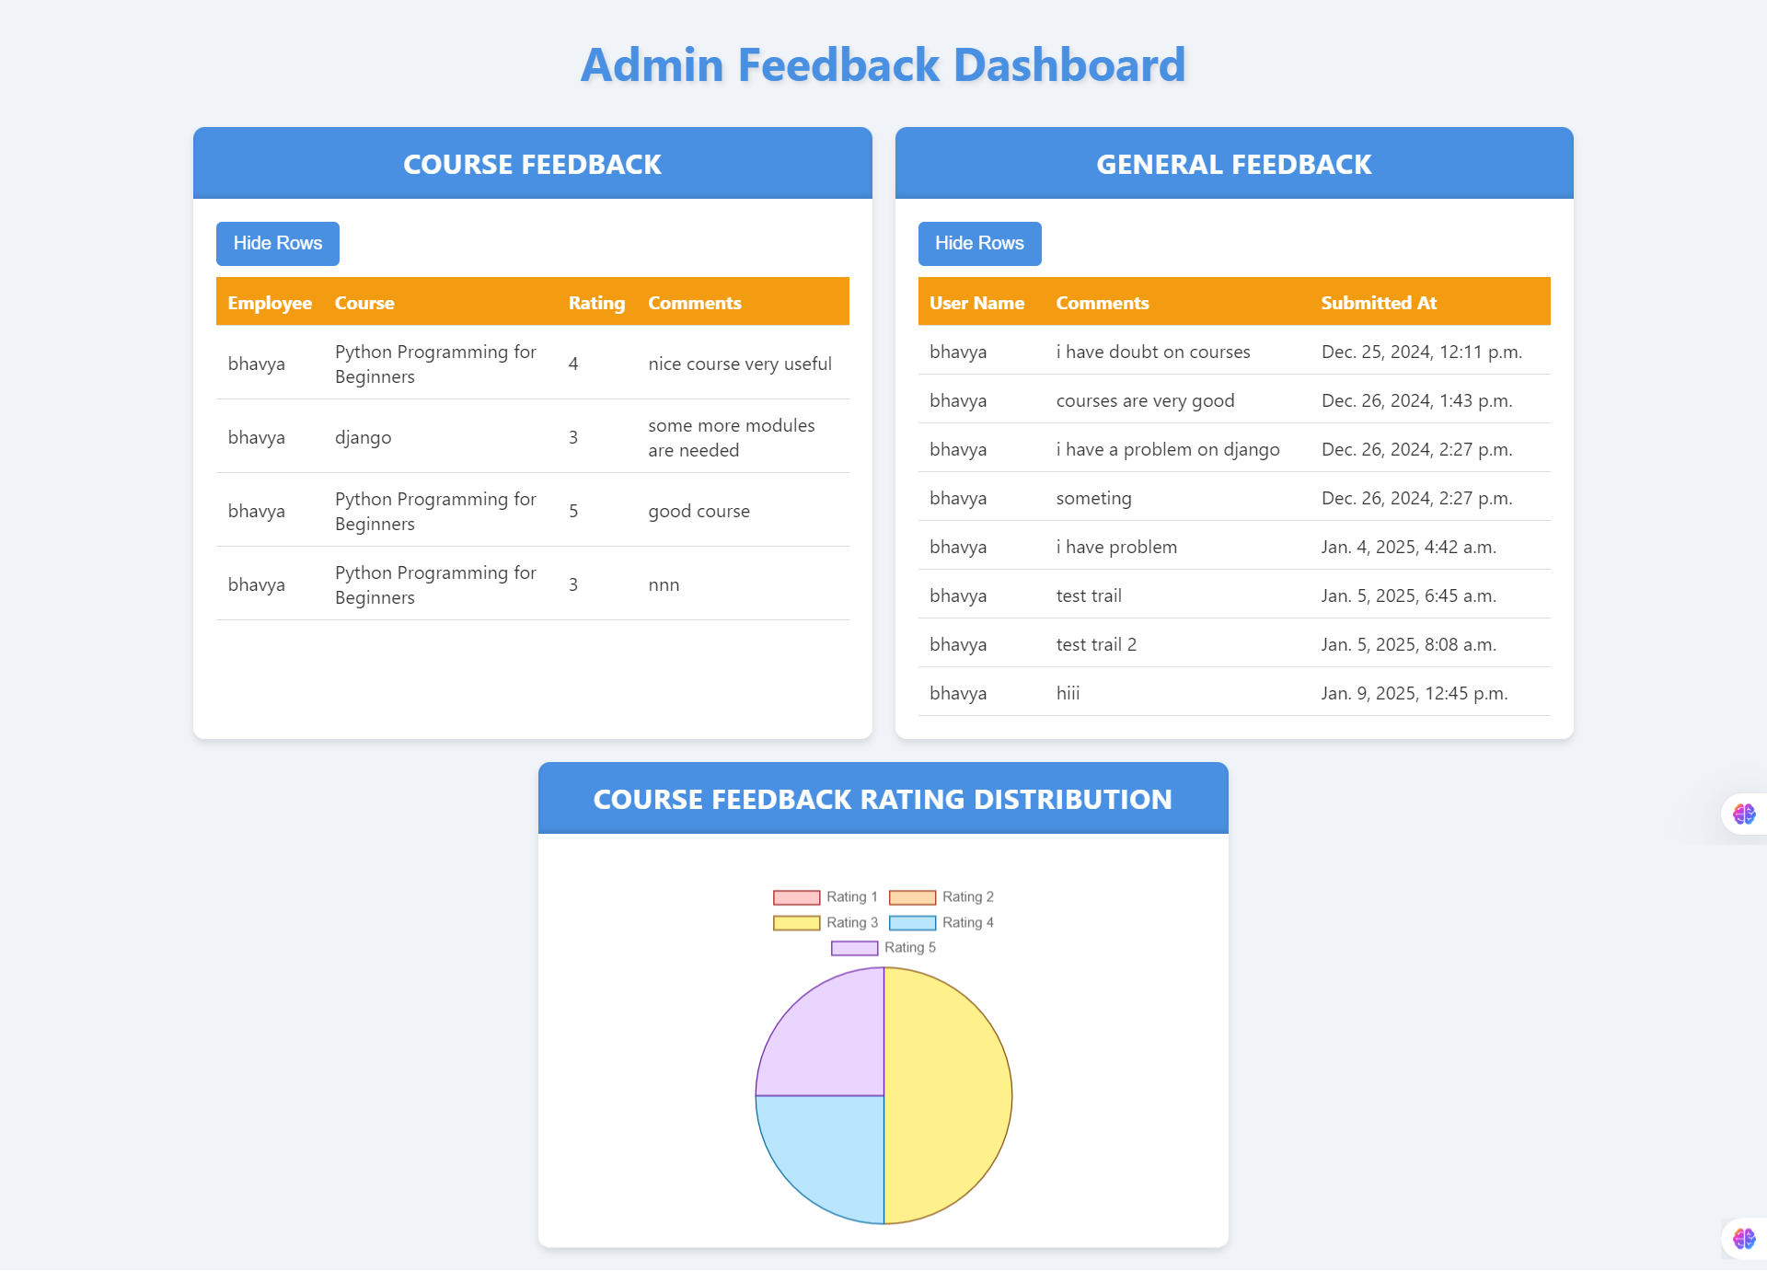

Slide 14
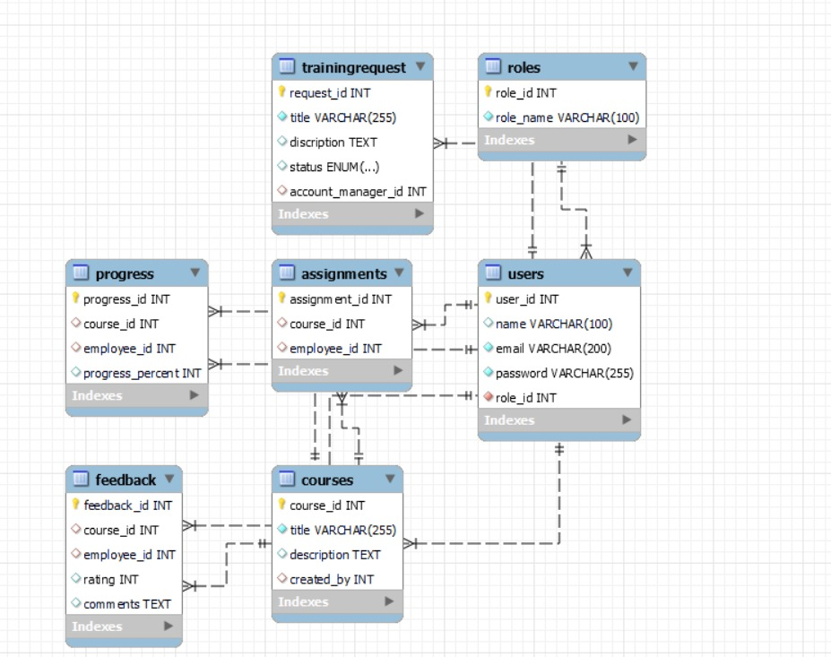
Database SCHEMA

Slide 15
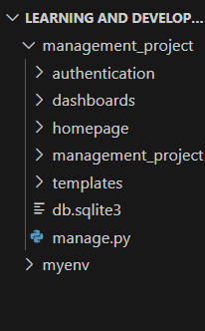
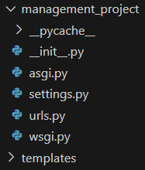
Backend file structure
Whole Project File Structure
Main Project file Structure

Slide 16
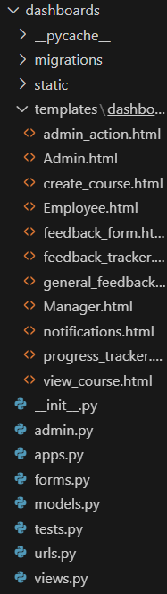
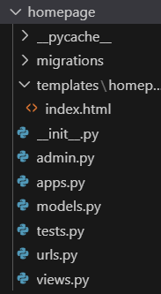
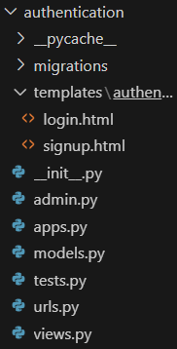
Django apps file structure
Homepage app
Authentication app
Dashboard app

Slide 17
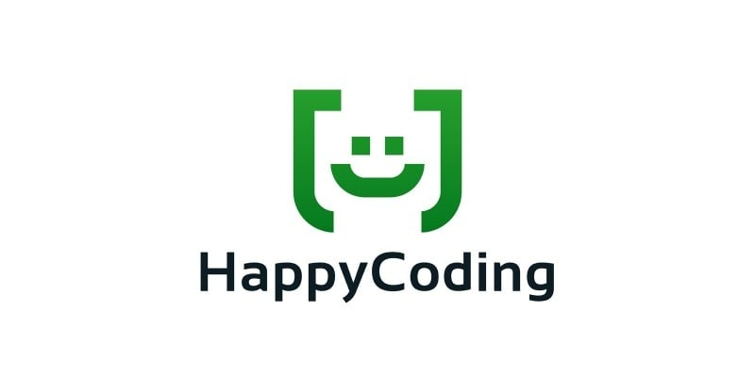
Thank you

